Slide 1
Drugs, Drug policy, Harm Reduction: A Reality Check
Judy Chang
Executive Director, INPUD

Slide 2
Drugs, Drug Policy, Harm Reduction: A Reality Check
The Perspective of People who use Drugs

Slide 3
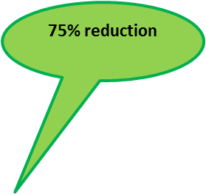
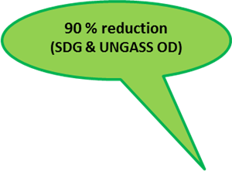
Drug use Worldwide and HIV
We were here at end of 2015
+33%
Missed 50% reduction target (UNGASS)

Slide 4
Criminalization as an Intervention
Evidence presented here indicates that, in the absence of reforms to current legal and policy frameworks, attempts to end both the HIV and HCV epidemics, and to reduce the harms associated with injection drug use, will continue to fail. What DeBeck and her colleagues have given us is the evidence. What we need now is the political will and the courage to act (Maher & Dixon 2017, The Lancet)

Slide 5
Prohibitionist Drug Policy, Violence & HIV

Slide 6
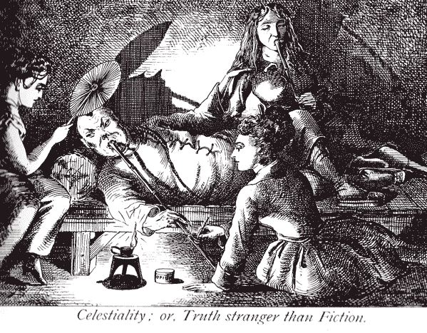
Drug Policy as a Means of Social Control By Governments
“It is not people who use drugs who are broken, but the system that fails to address their needs.” Community Consultation participant

Slide 7
Harm Reduction at a Cross Roads
World Bank
Source: Mathers et al. (2010) – image from prevention coalition – or at least targets.

Slide 8
Nothing about us without us
‘Drug user organizing draws upon the work of other movements for social justice. Heavily influenced by the AIDS movement, drug user organizing carries forward the Denver Principles, which reject victimization.’
Excerpted from: Jennifer Flynn, Drug User Organizing Training Manual

